Slide 1
Rational Neural Networks for Approximating Jump Discontinuities of Graph Convolution Operator
Zhiqian Chen, Feng Chen, Rongjie Lai, Xuchao Zhang, and Chang-Tien Lu

Slide 2
Agenda
WRITE SOMETHING HERE
Motivation
Graph convolution operator applies polynomial approximation on spectra.
How good or bad is the approximation?
Method
Rational function is more precise than polynomials
Remez exchange algorithm is applied to derive the coefficients
Experiments
Synthetic data
Road networks analysis
Conclusion

Slide 3

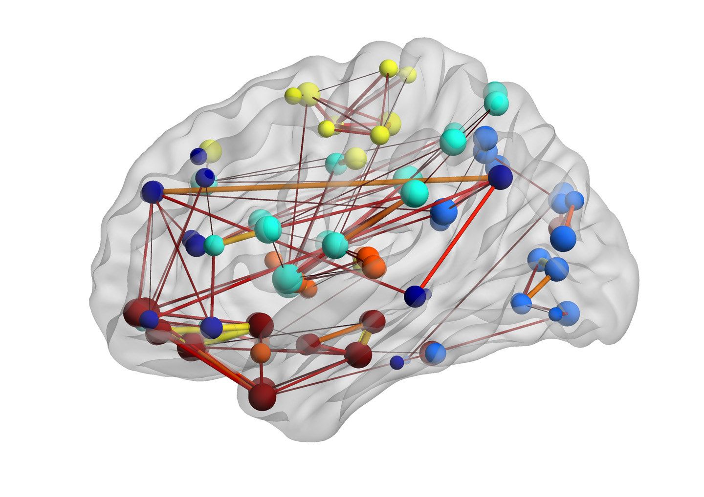
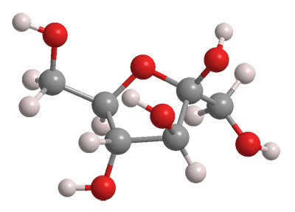

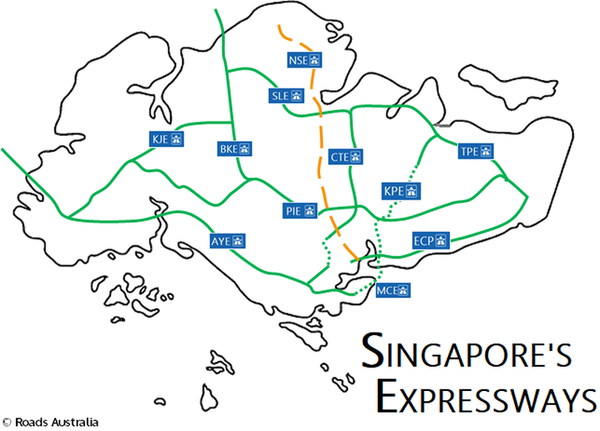
Background
Graph/networks are everywhere
Brain
Networks
Molecular
Networks
Social
Networks
Road
Networks

Slide 4
Related Works
Spectral Graph & Approximation
First model using approximation theory for spectral graph analysis
Simplifying ChebNet by truncating order of approximation polynomials
Spectral
Graph CNN
ChebNet
Defferrard et al.(NIPS 16)
Bruna et al.(ICLR 15)
First model using spectral graph theory
Wavelets
on graphs
First NN model using approximation theory for spectral graph analysis
GCN
Kipf & Welling(ICLR 17)
Hammond et al.
(Applied and computational
Harmonic analysis 11)

Slide 5
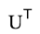
Is the approximation really working?
WRITE SOMETHING HERE
g( ) X = Z
( * is convolution operator)
g( )
X’
convolution theorem
g( )* X’
g( ) * X’ = Z
(* is element-wise multiplication)

Slide 6
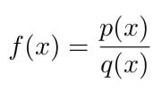
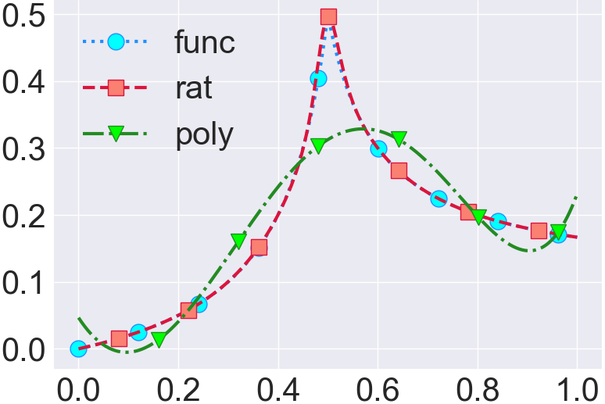
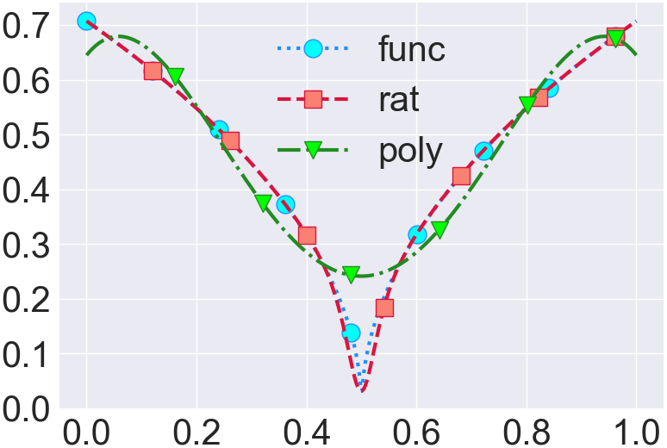
Polynomials approximation
Rational approximation
Approximation
Theory
simple form, well known properties
computationally easy to use
notorious for oscillations between exact-fit value
only high degree can model complicated structure
poor interpolatory/extrapolatory/asymptotic properties
moderately simple form, not well-known properties
moderately easy to handle computationally
excellent for oscillations between exact-fit value
model complicated structure with a fairly low degree
excellent interpolatory/extrapolatory/asymptotic properties

Slide 7
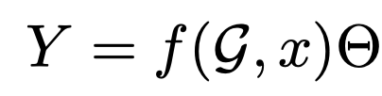
Problem Setting
graph signal regression
graph convolution
+
fully connected NN
graph convolution
Classification
Regression

Slide 8
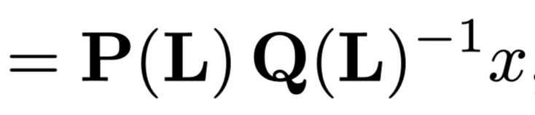
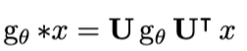
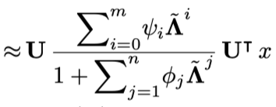
Rational function for approximating graph convolutional operator
Laplacian
POLYNOMIAL
Attribute
convolution theorem
RATIONAL

Slide 9
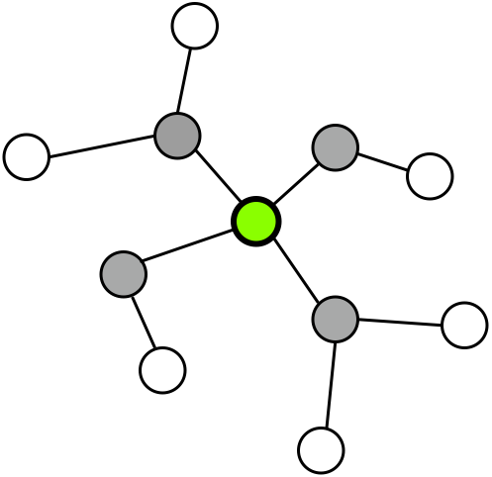



Physical Meaning of Rational Approximator
Smooth
Non-Smooth
POLYNOMIAL
RATIONAL
Label propagation
Label propagation
Reverse Label propagation
opposite direction can approximate
non-smooth signal
Polynomial is a special case of rational
GCN/ChebNet is special case of RationalNet

Slide 10
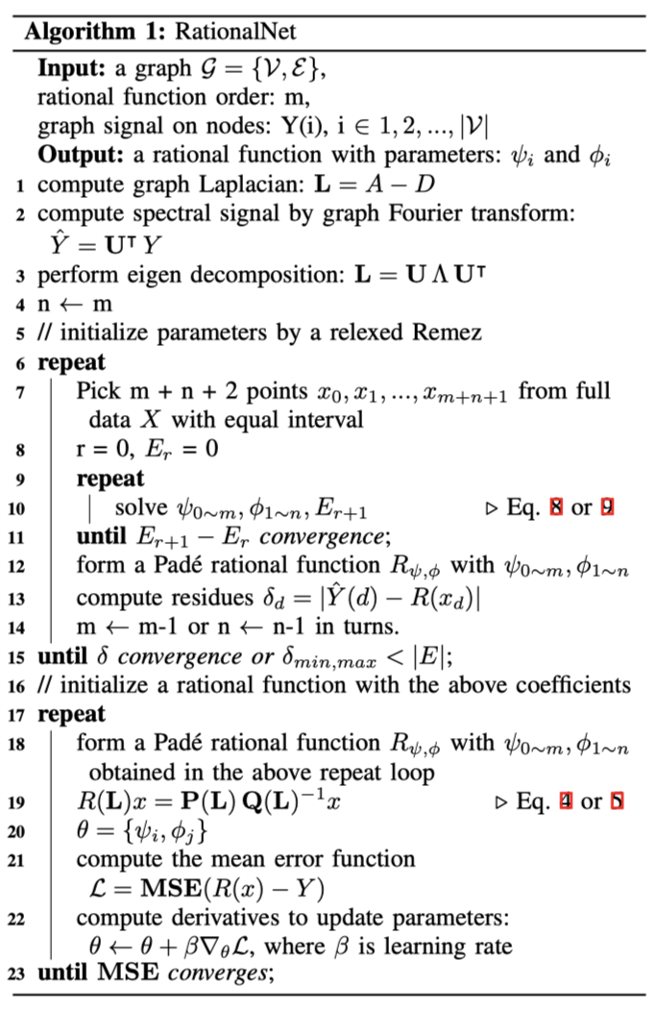
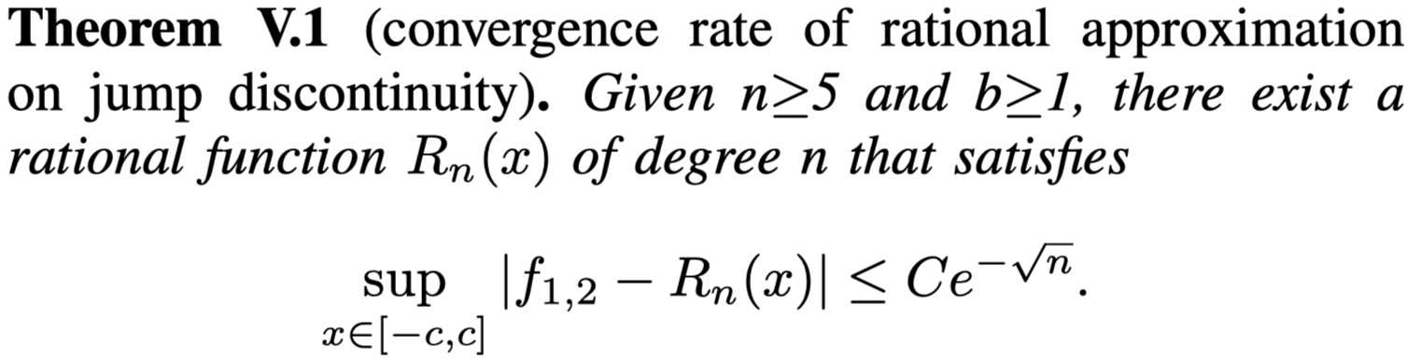
Algorithm: Remez exchange
relaxed version
Prepare training data
Optimization by equioscillation constraint
Check stopping rule
Relaxed Remez
When the order is greater than 5
RationalNet is better than GCN/ChebNet

Slide 11
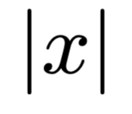
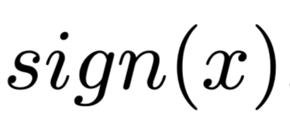
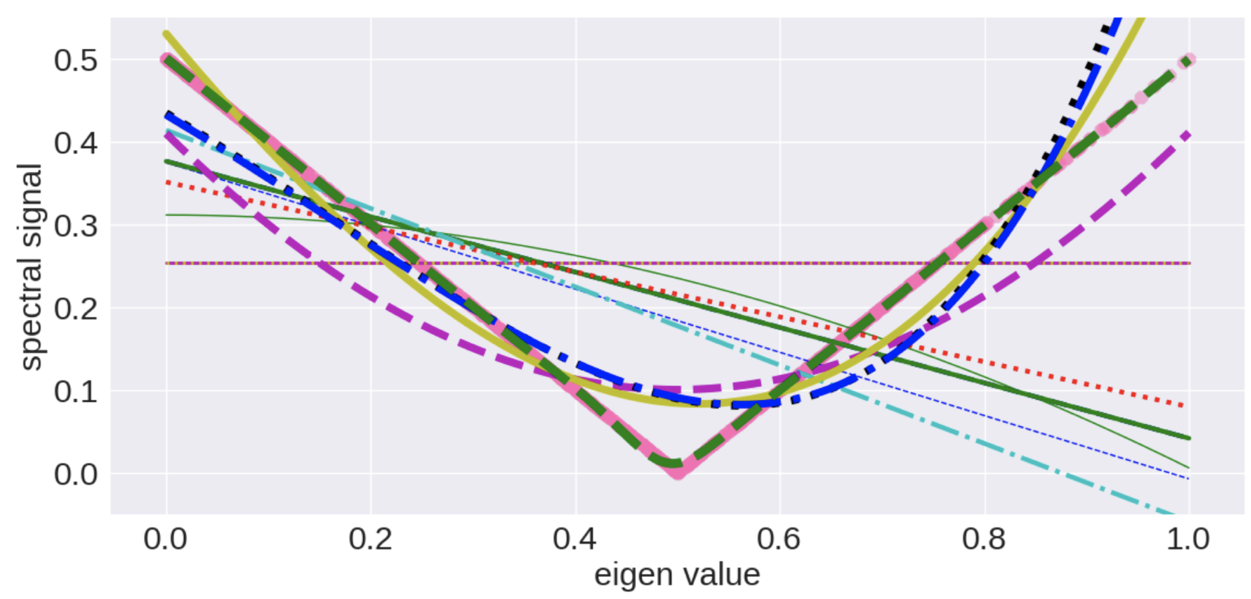
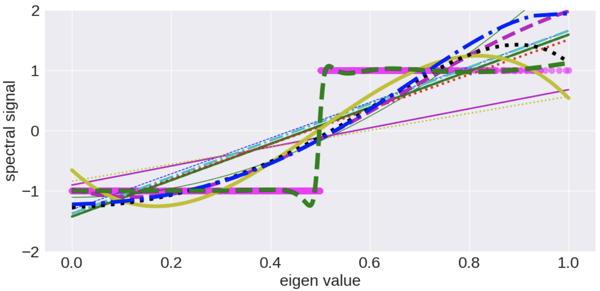

Experiments
synthetic data

Slide 12
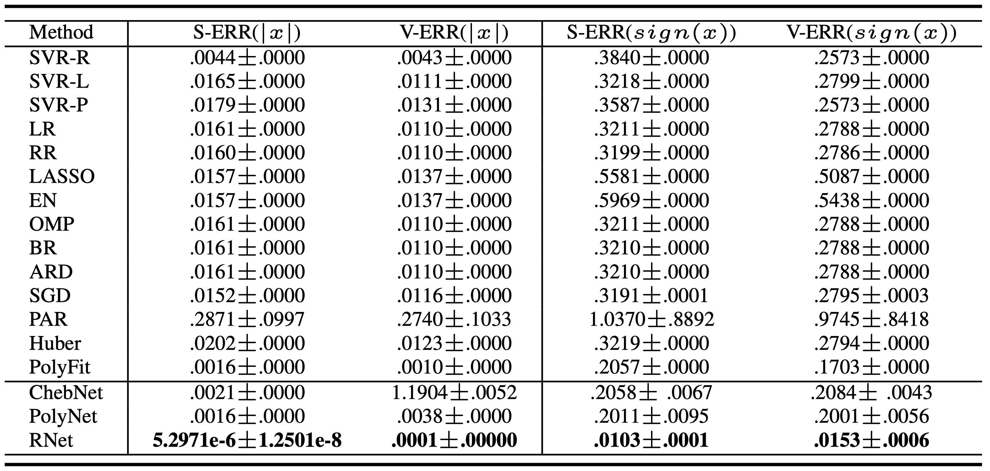
Experiments
synthetic data

Slide 13
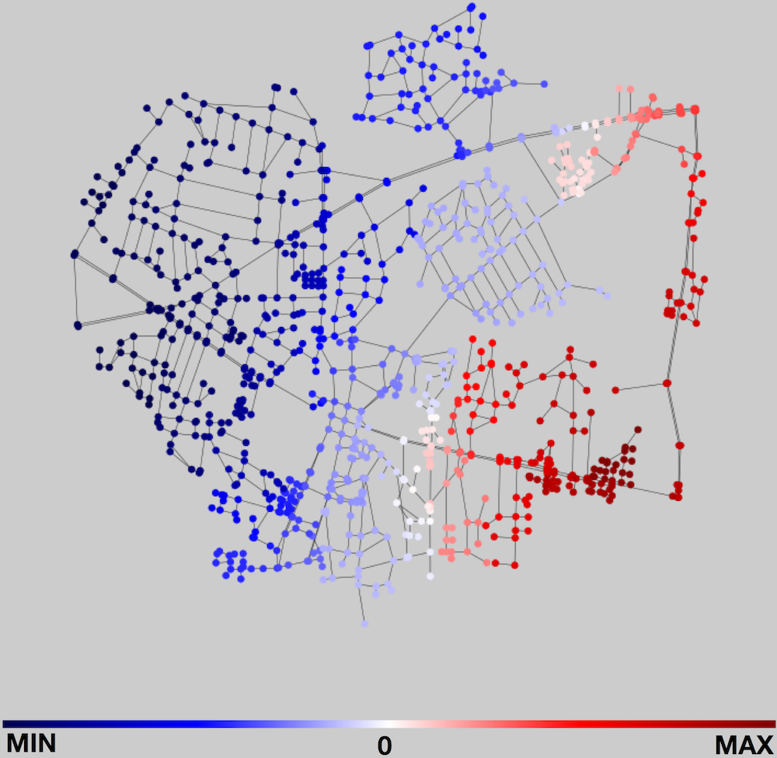
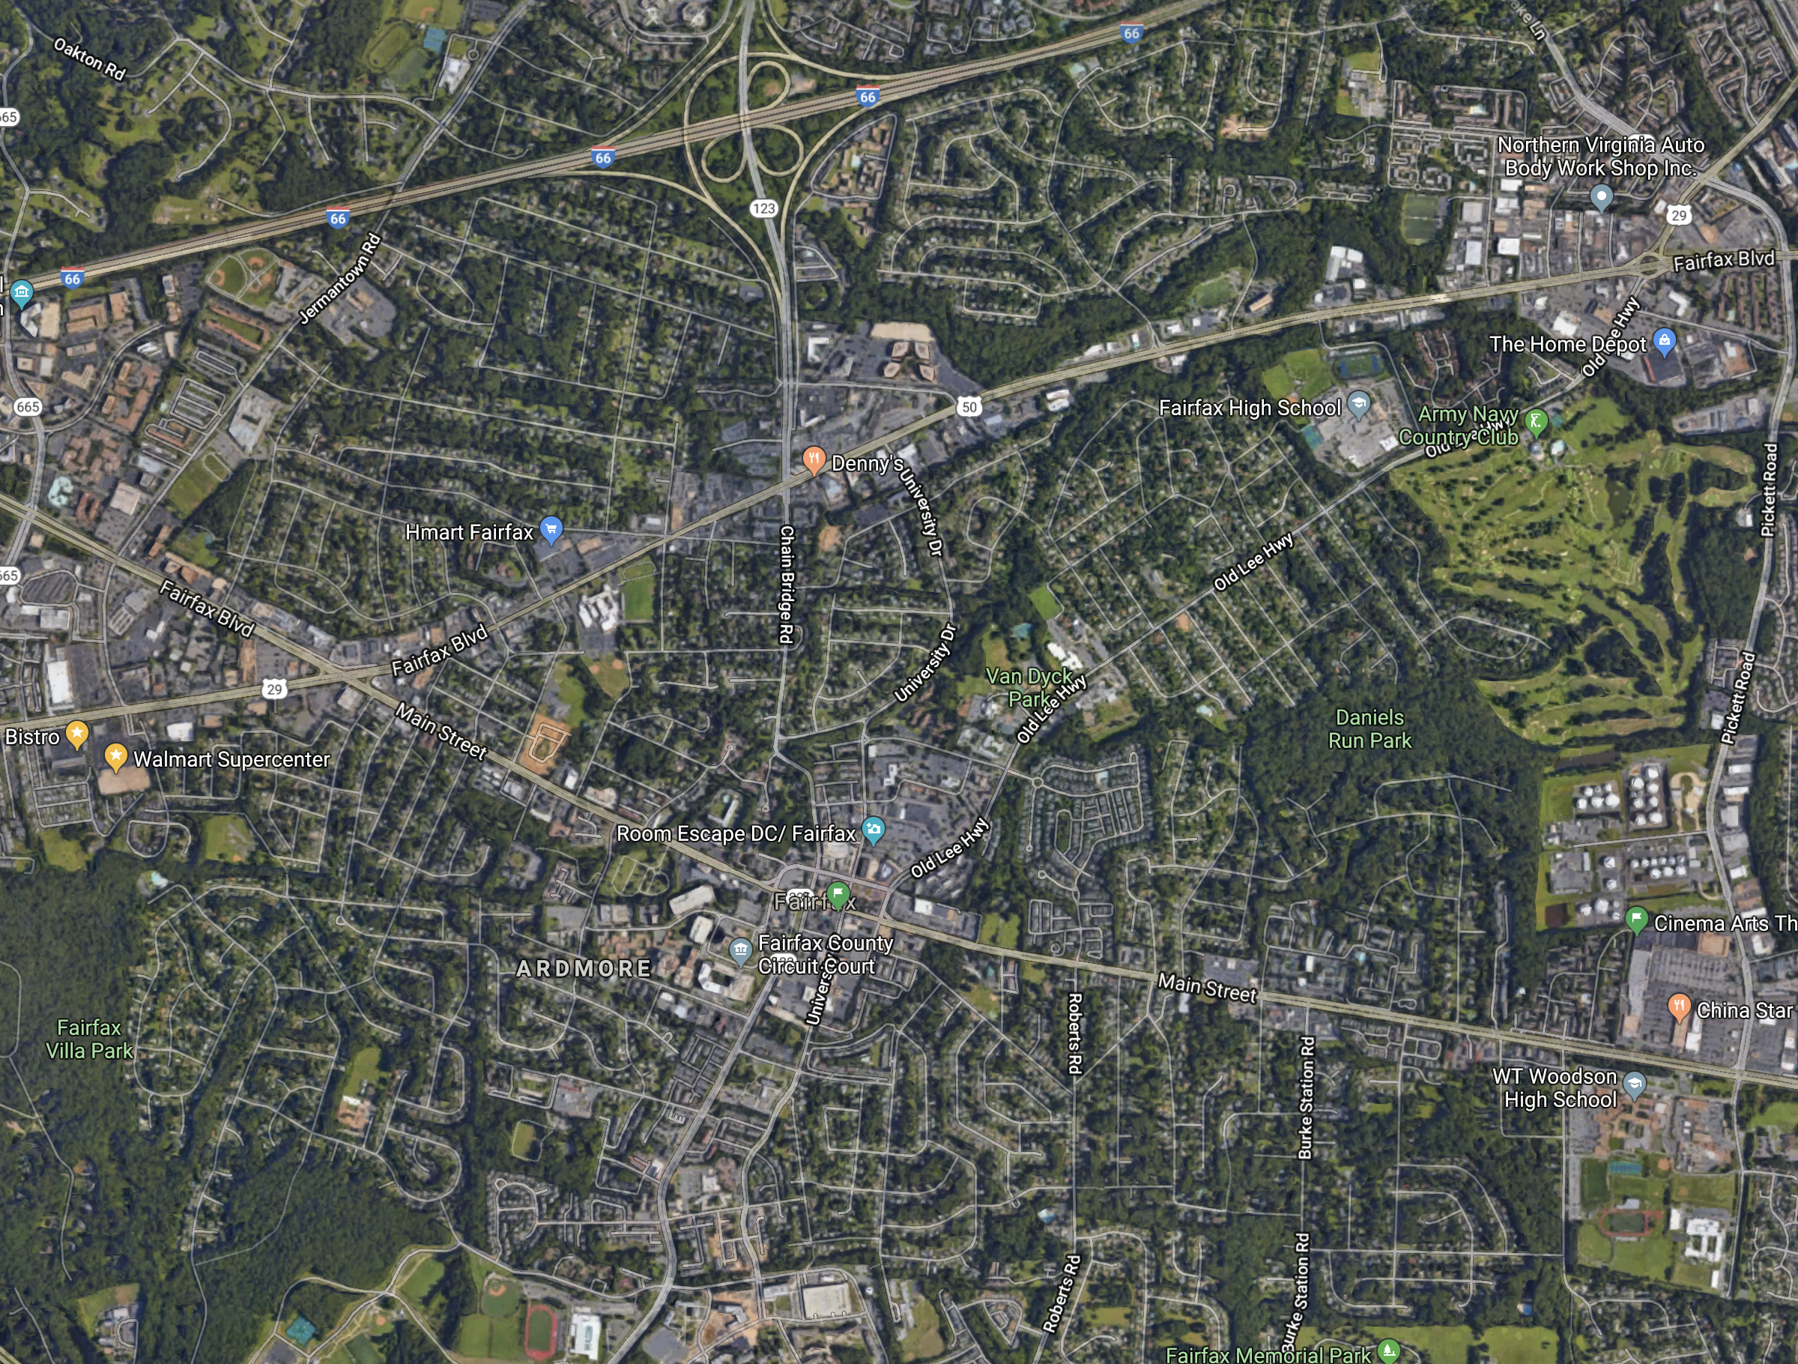
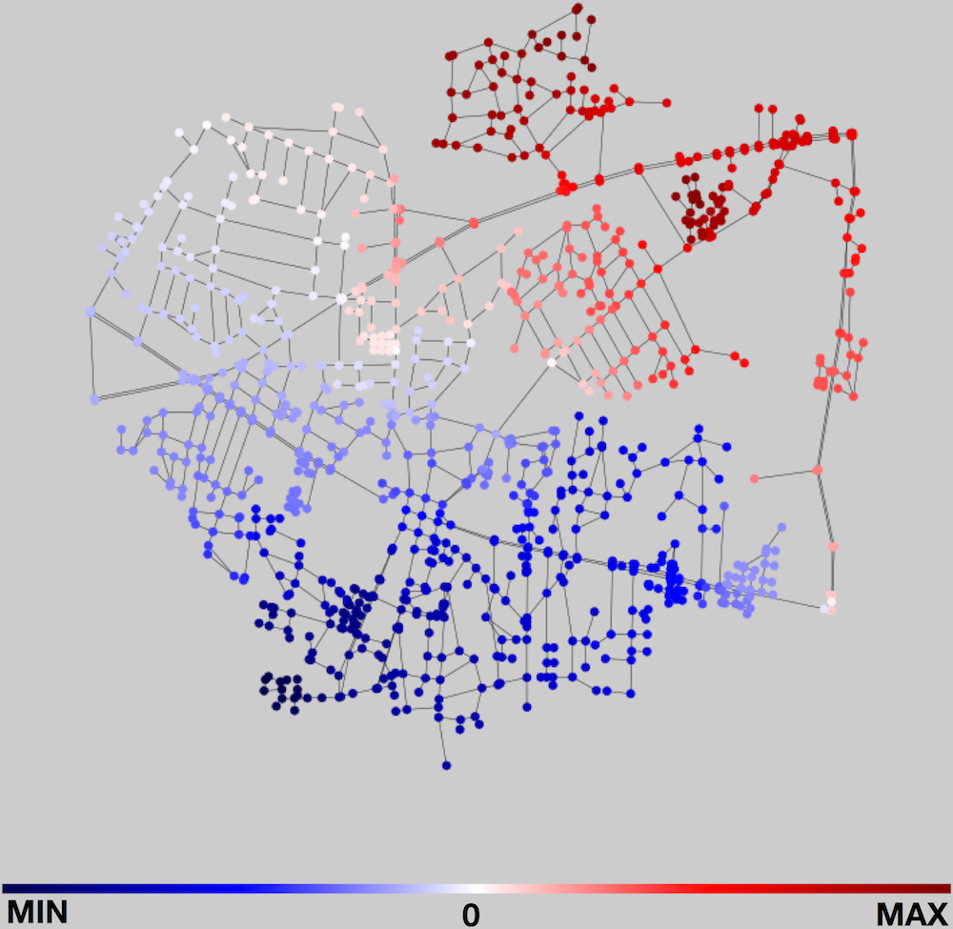
Experiments - Fairfax road
WRITE SOMETHING HERE

Slide 14
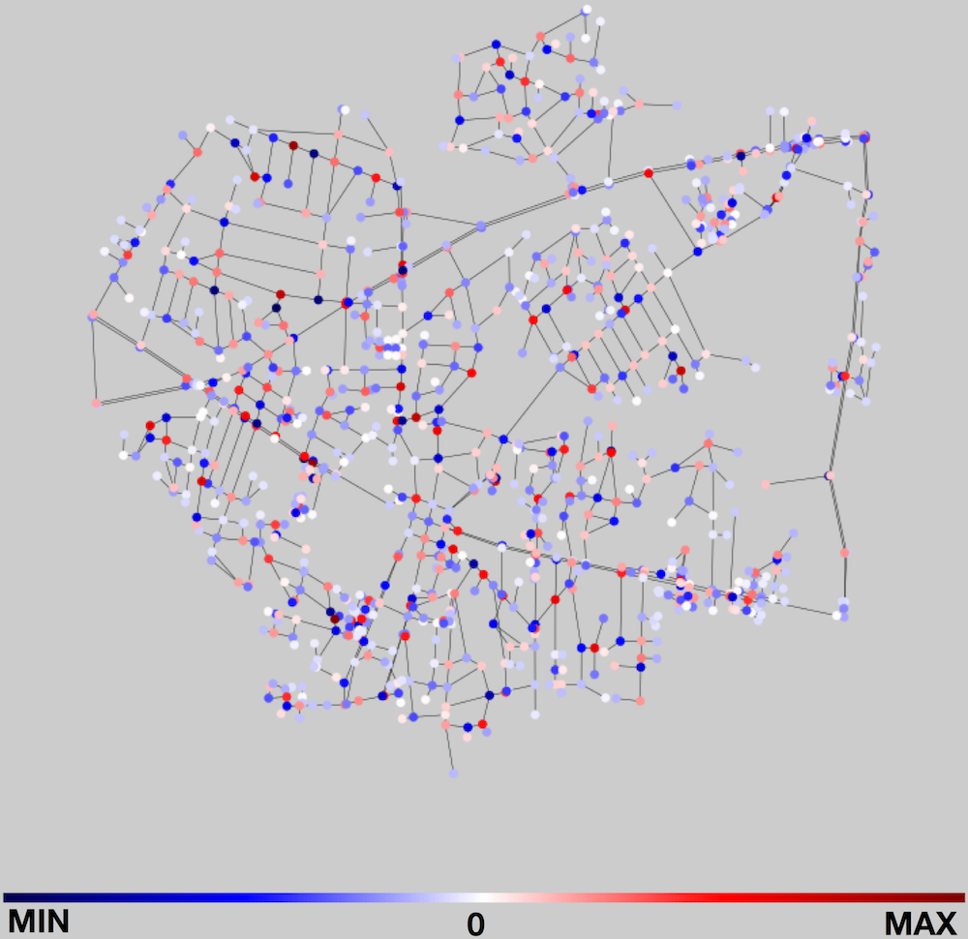
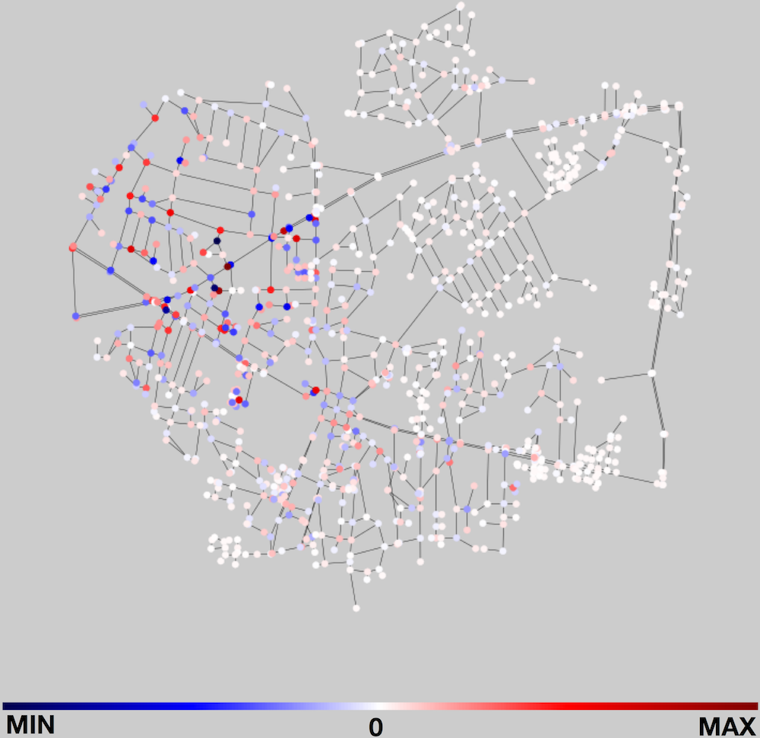
Real world case study
Experiments - Fairfax road
highpass ﬁltering
Low Frequency
High Frequency
Smooth
Non-smooth
Dirichlet energy
0.00250
Dirichlet energy
6376.54224
Dirichlet energy:
0.00296
Dirichlet energy:
3.82741

Slide 15
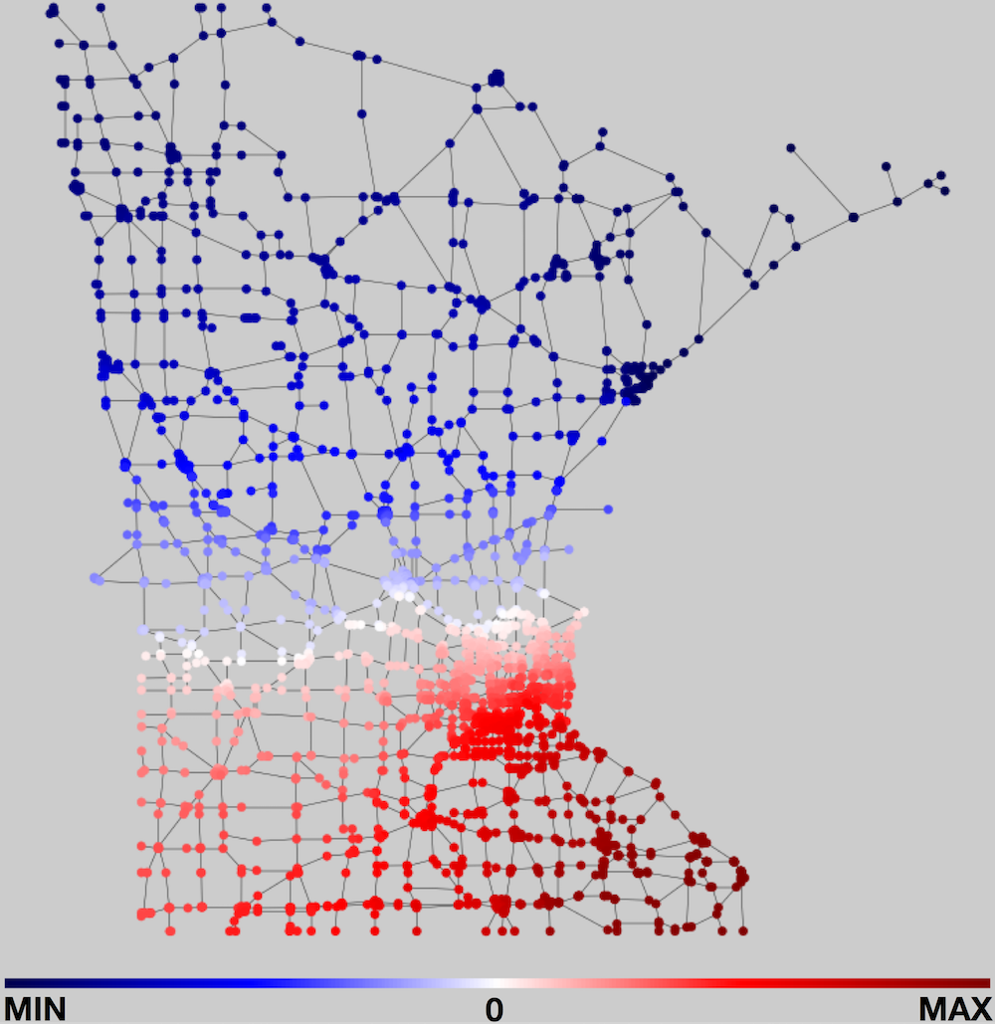
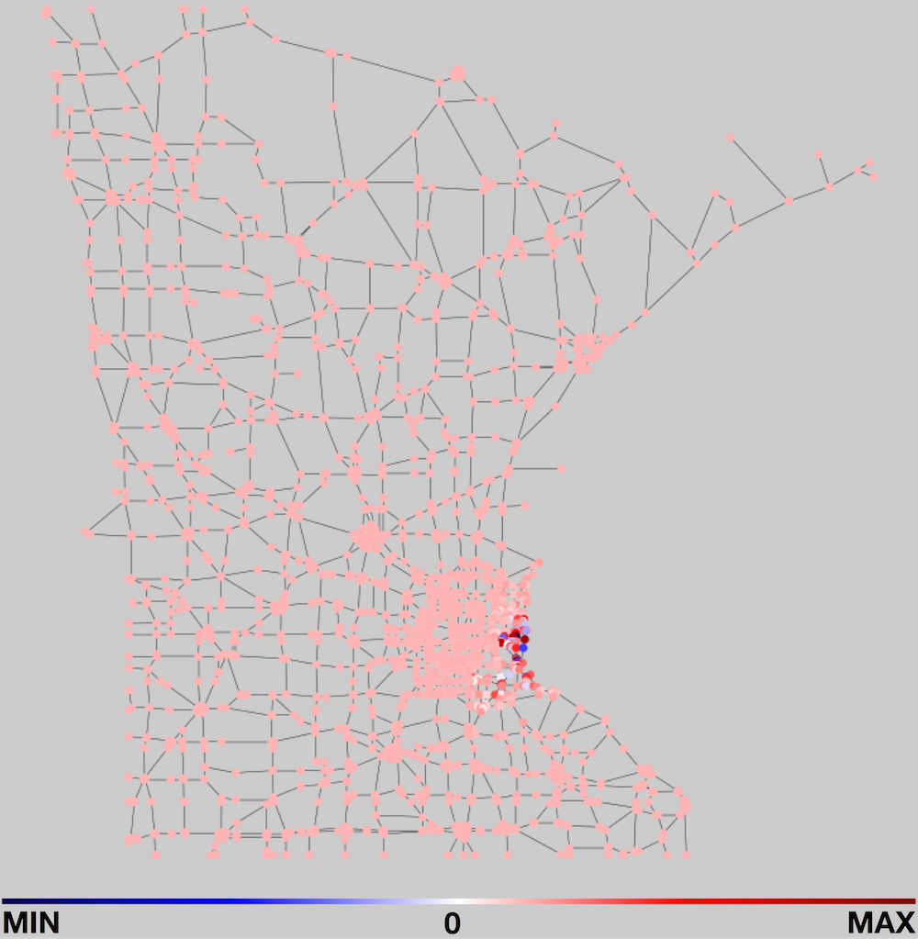
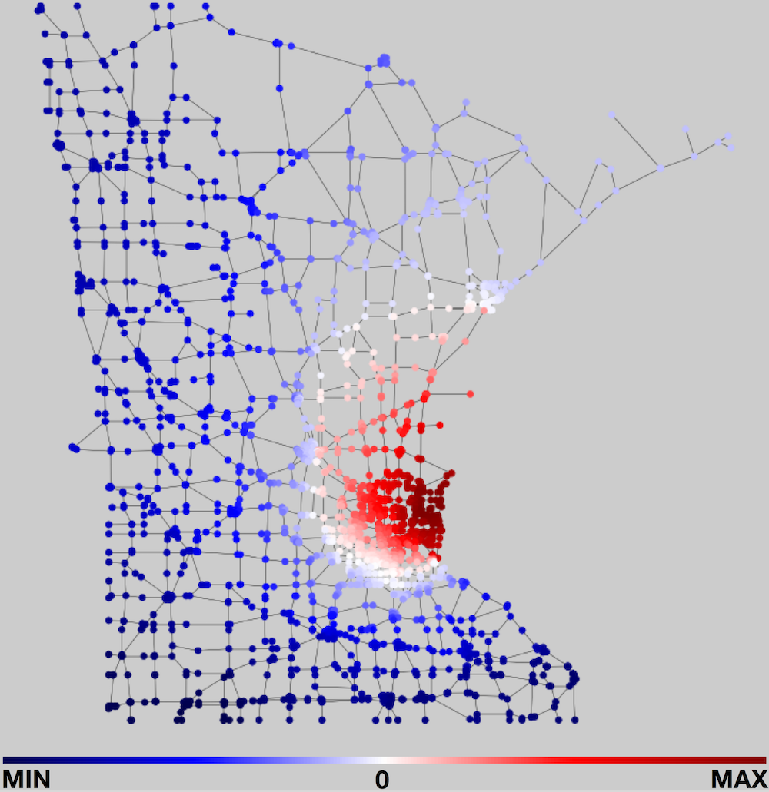
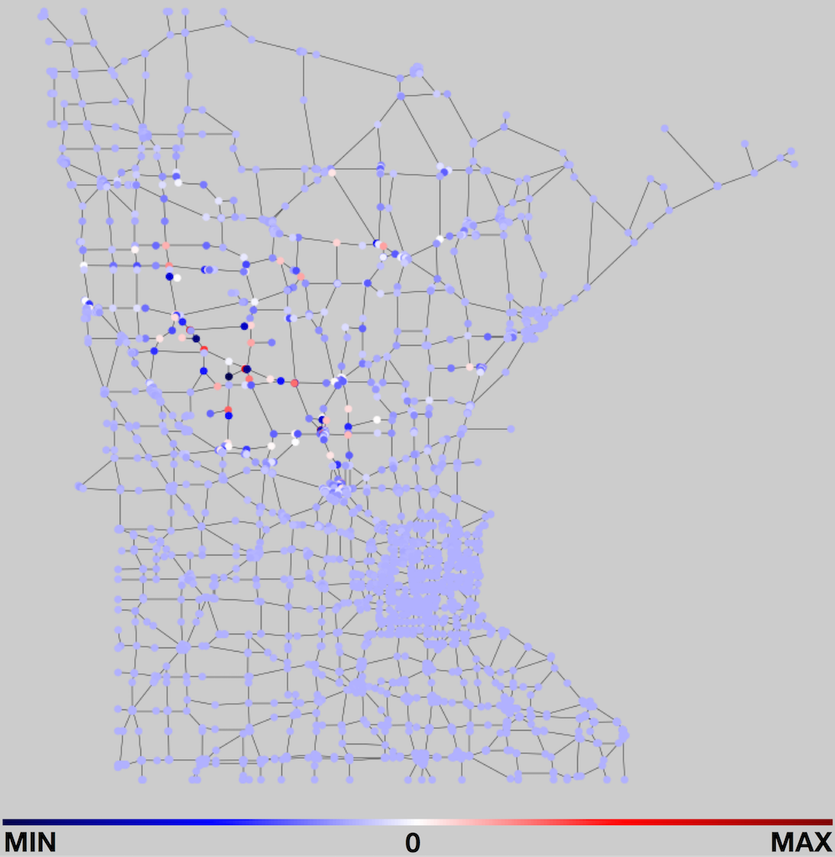
Real world case study
Experiments - Minnesota road
Low Frequency
High Frequency
Smooth
Non-smooth
Dirichlet energy
0.00084
Dirichlet energy
4.04661
Dirichlet energy:
0.00207
Dirichlet energy:
4.03932

Slide 16
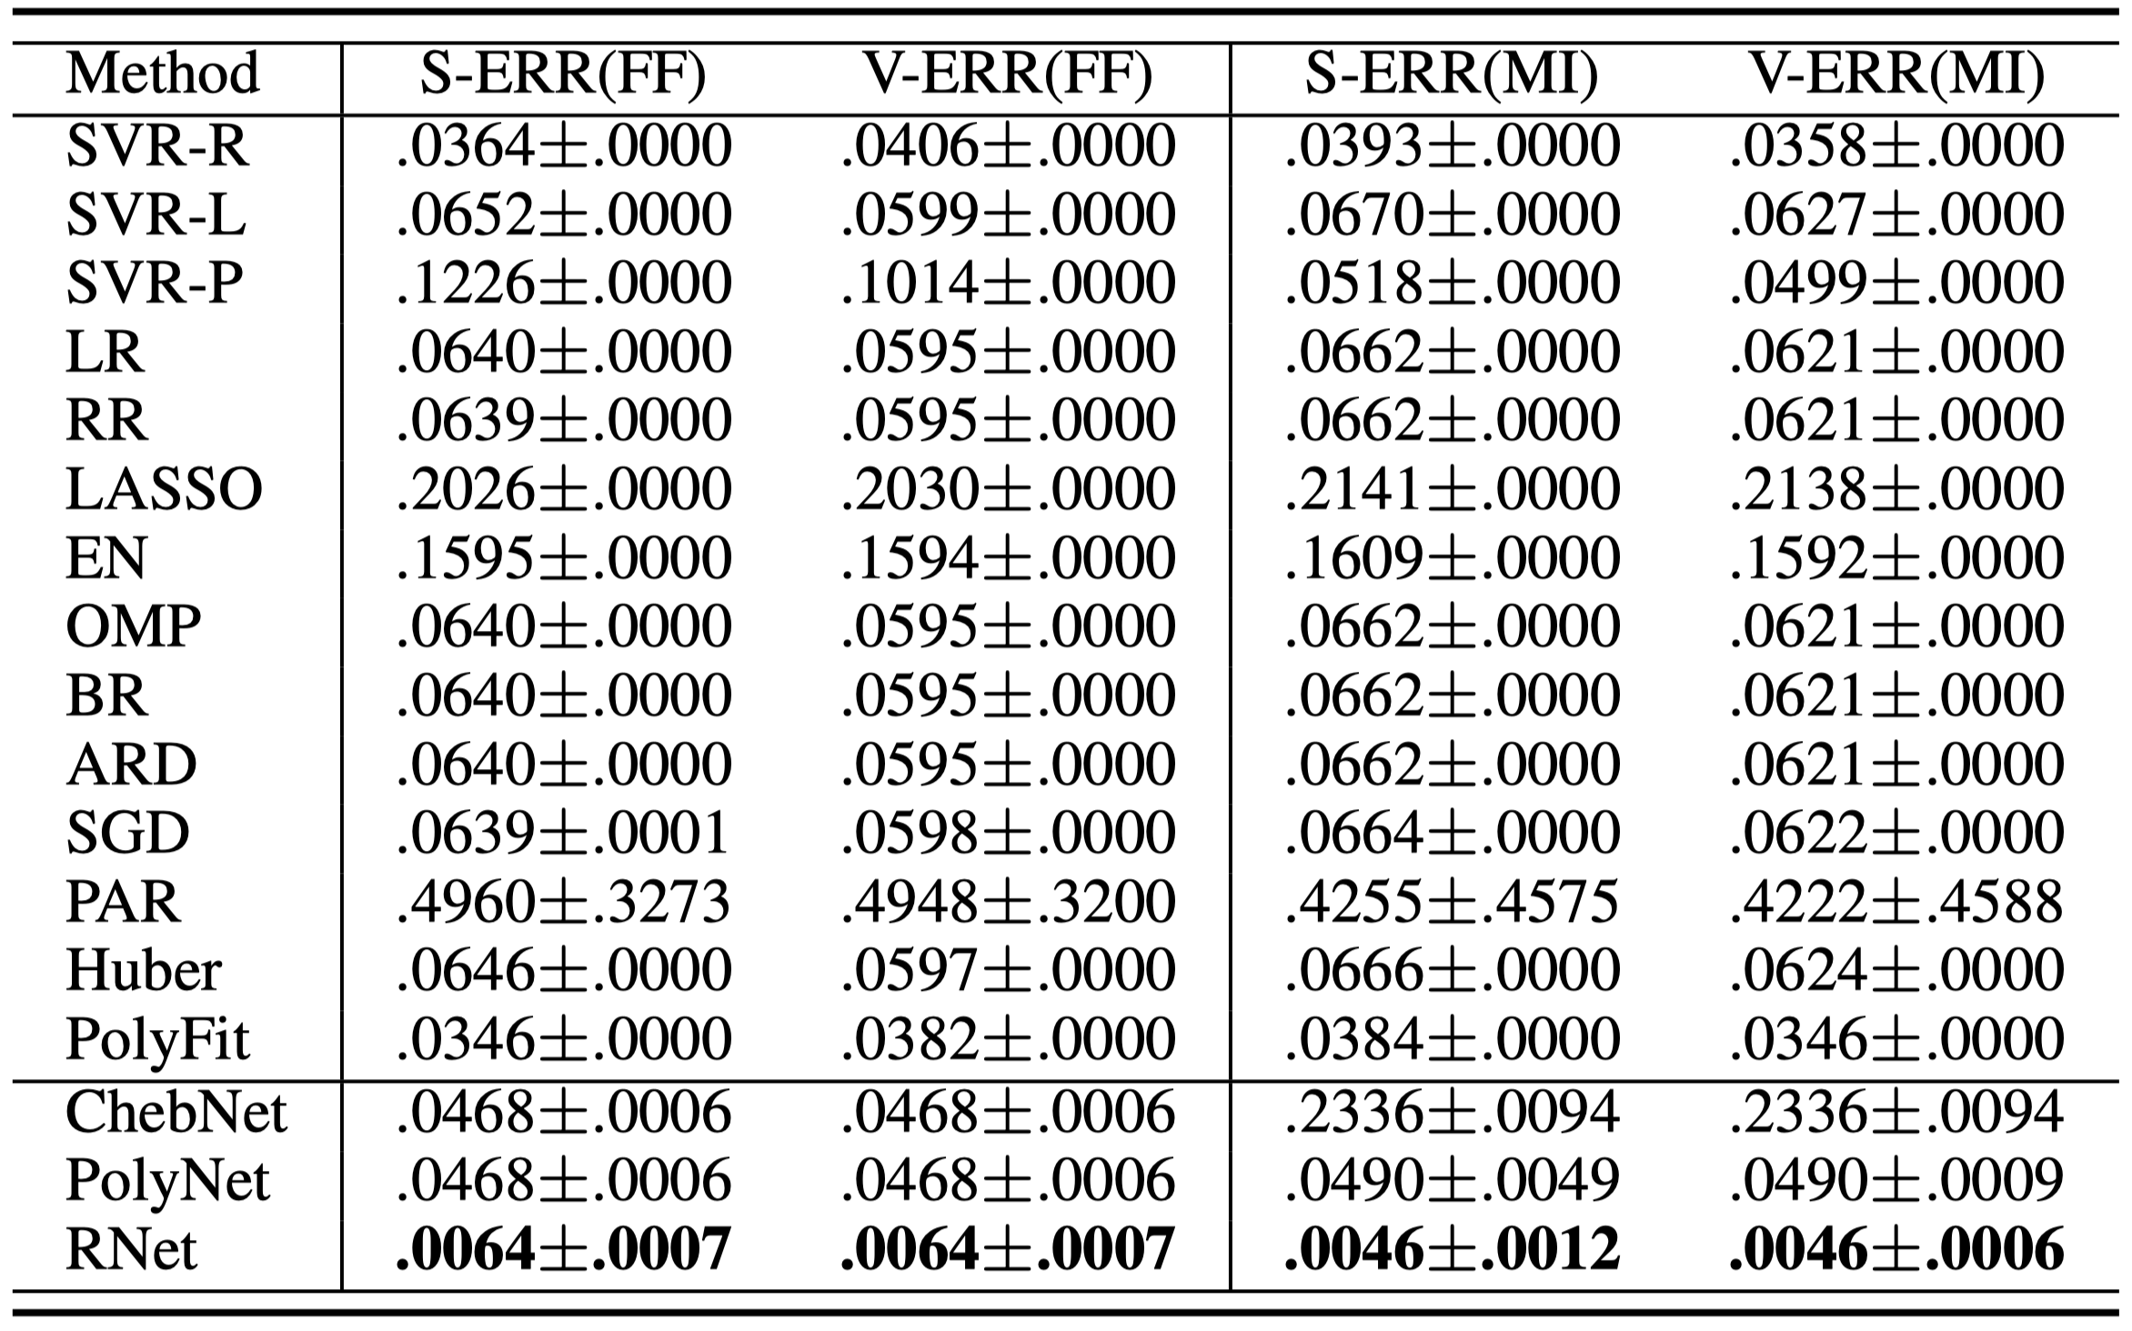
Experiments - Minnesota/Fairfax

Slide 17
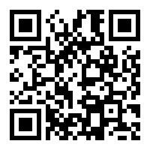
Thank you!
Will provide more!

